Slide 1

Automata theory and logic: nfa to dfa
By:- Arshit arora (E20cse024) eb07

Slide 2
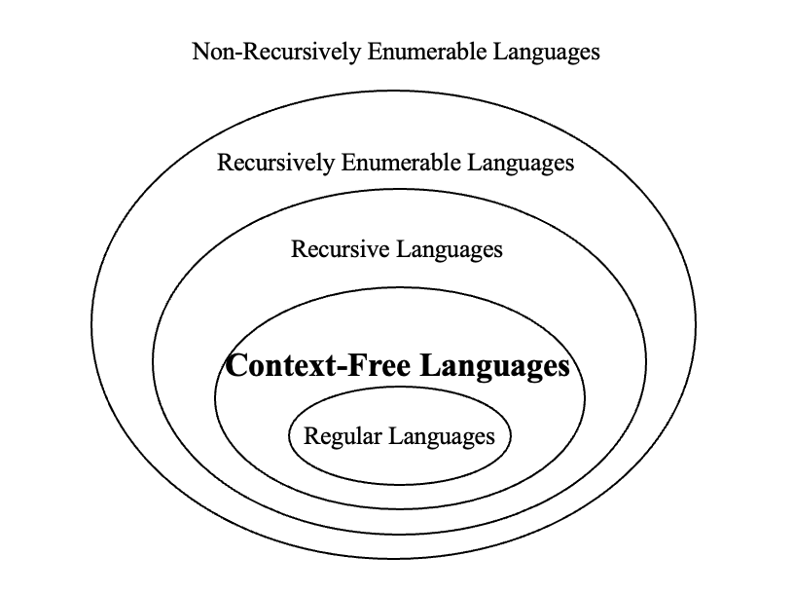

Hierarchy of language
Regular Languages > Finite State Machines, Regular Expressions.
Context Free Language > Context free grammar, Push Down Automata (PDA)

Slide 3
Finite Automata (FA)
FA with Output
DFA
Mooley
FA without Output
NFA
NFA epsilon
Mealy

Slide 4
Finite automata with output
moore
mealy
Moore machine is a finite-state machine whose current output values are determined only by its current state. This is in contrast to a Mealy machine, whose output values are determined both by its current state and by the values of its inputs.
a Mealy machine is a finite-state machine whose output values are determined both by its current state and the current inputs. This is in contrast to a Moore machine, whose output values are determined solely by its current state

Slide 5
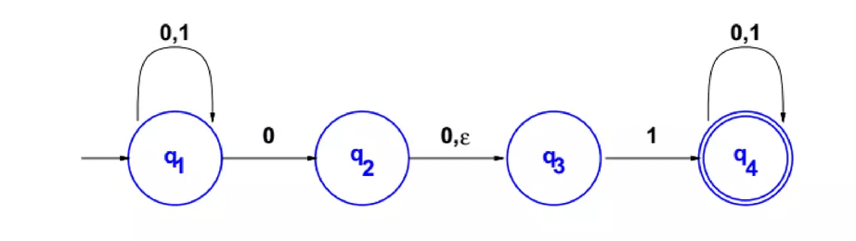
Non-deterministic finite automata (Nfa)
An NFA may have more than one transition labeled with certain symbol.
An NFA may have no transition labelled with certain symbol.
Transition may be labeled with ε, the string.
NFA’s are usually easier to design than equivalent DFA’s
Every DFA is also a NFA(Non-Deterministic finite automata)

Slide 6
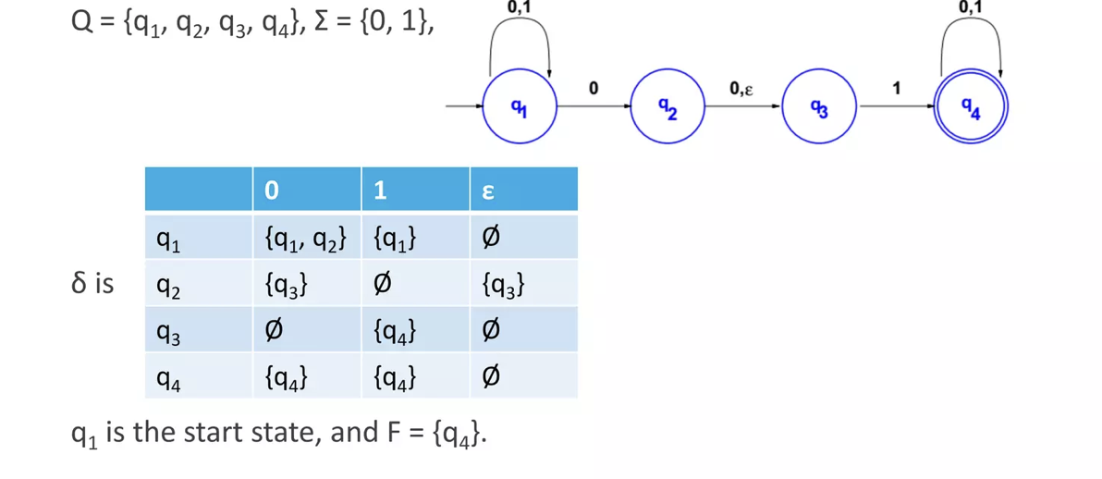

Slide 7
DFA v/s nfa
dfa
nfa
For every string x, there is a unique path from initial state and associated with x. x is accepted if and only if this path end at a final state.
For every string x, there may exist none or more than one from initial state and associated with x.

Slide 8
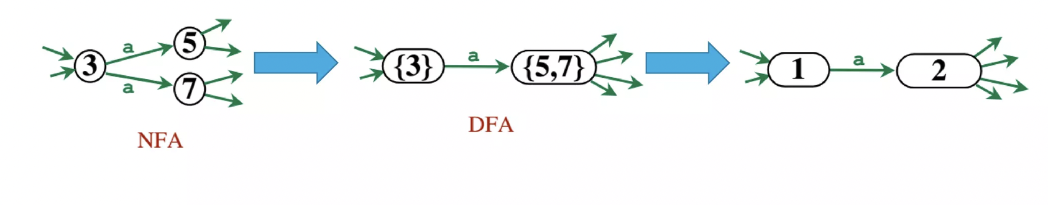
Expressive power of nfa and dfa
Deterministic Finite Automata(DFA) and Non-Deterministic Finite Automata(NFA) have same expressive power.
Given an NFA N, then we construct a DFA M, that accepts the same language.

Slide 9
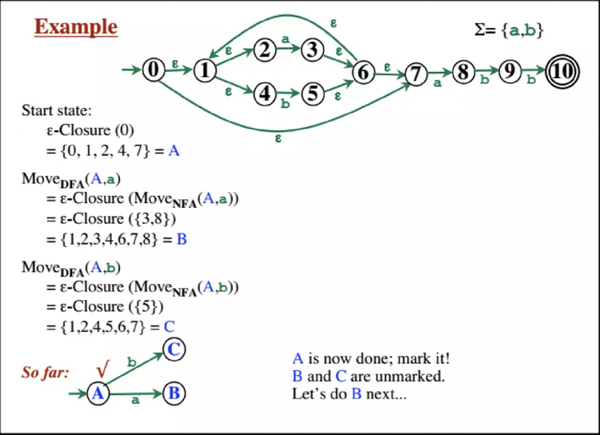
Converting nfa to dfa

Slide 10
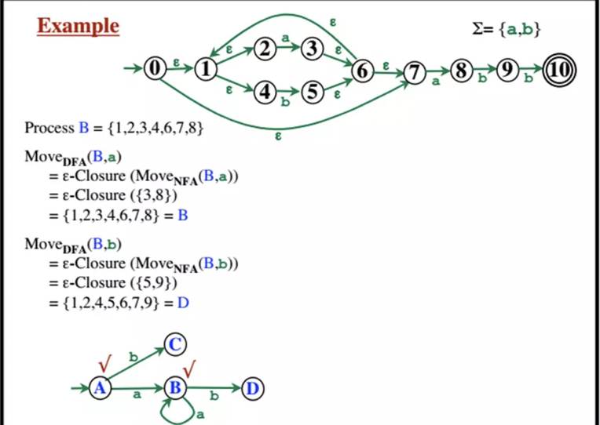

Slide 11
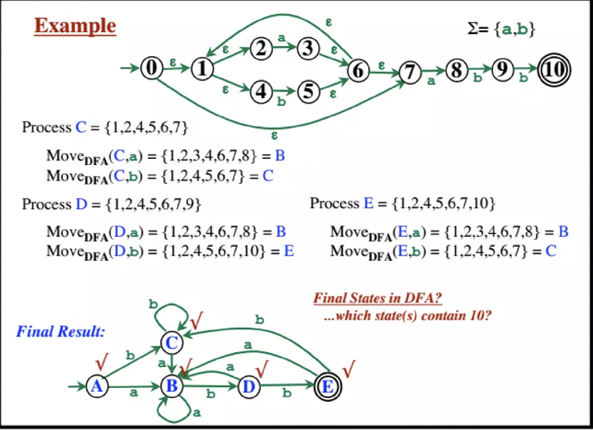

Slide 12
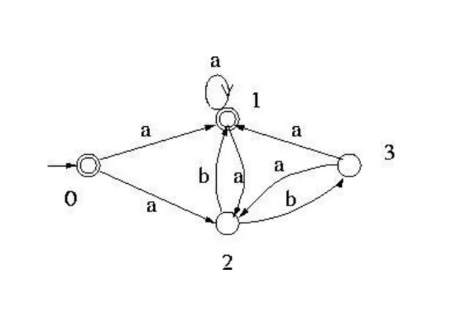
Another example

Slide 13
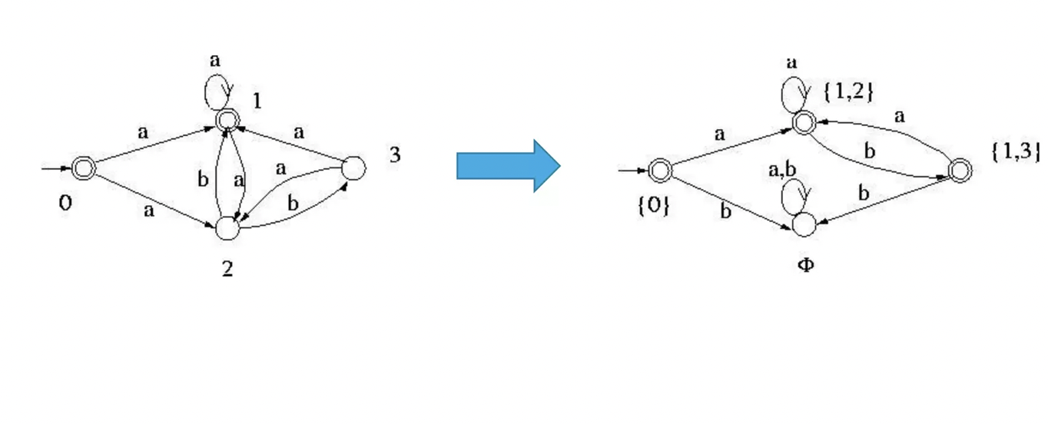
Another example

Slide 14
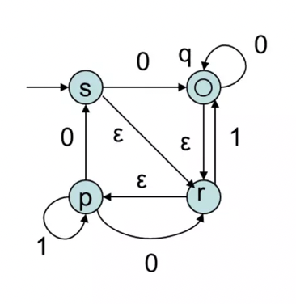

Slide 15
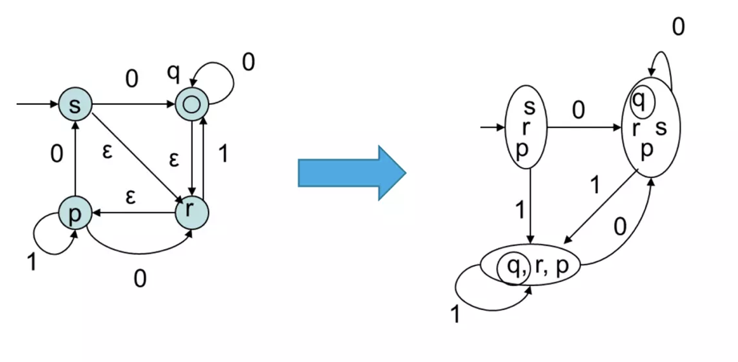

Slide 16
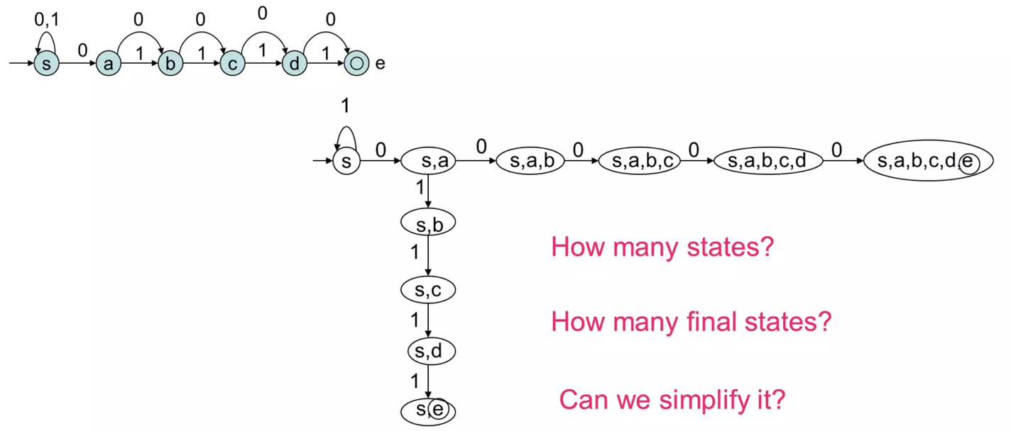

Slide 17
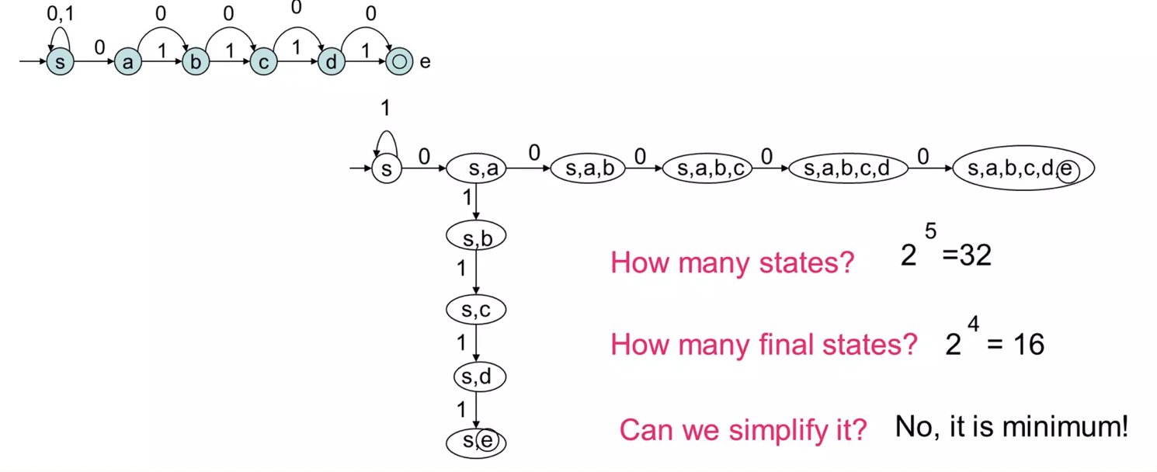

Slide 18
Conversion of moore to mealy machine.
As mentioned before as well Mealy machine is an FSM(Finite State machine) whose output depends on the present state as well as the present input.
A Moore machine is also an FSM(Finite State machine) whose outputs depend on only the present state.
Moore machine cannot directly convert to its equivalent Mealy machine because the length of the Moore machine is no longer than Mealy machine for the given input.
To convert Moore machine to Mealy machine state output symbols are distributed into the input symbol paths.

Slide 19
Steps to convert moore to mealy machine
STEP-1 > Take a blank Mealy Machine transition table format.
STEP-2 > Copy all the Moore Machine Transition states into the table format.
STEP-3 > Check the present state and their corresponding outputs in the Moore Machine state table. If for a state Q, output is m, copy it into the output columns of the Mealy Machine state table wherever Q, appears in the next state.

Slide 20
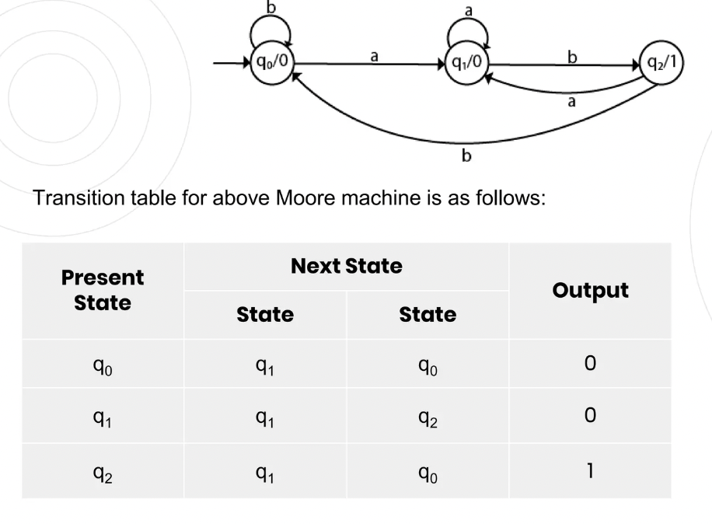
Example 1:

Slide 21
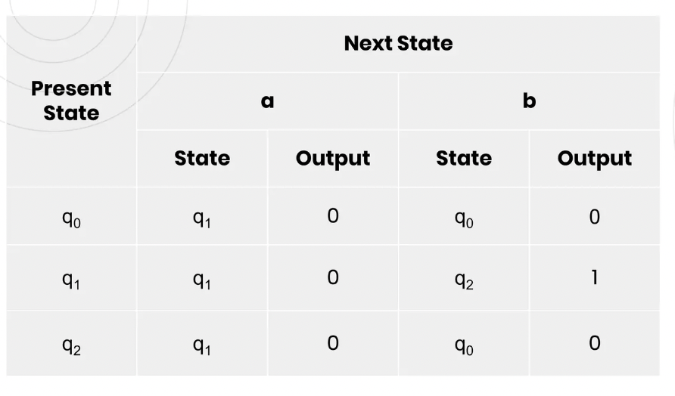
Transition table of the mealy machine:

Slide 22
Conversion of mealy machine to moore machine.
To convert Mealy machine to Moore machine, we will create a separate state for every new output symbol and according to incoming and outgoing edges are distributed.
STEP-1 > For each state(Qi), calculate the number of different outputs that are available in the transition table of the Mealy machine.
STEP-2 > Copy state Qi. If all the outputs of Qi are the same. Break Qi into n states as Qin, if it has n distinct outputs where n = 0,1,2….
STEP-3 > If the output of initial state is 0, insert a new initial state at the starting which gives 1 output.

Slide 23
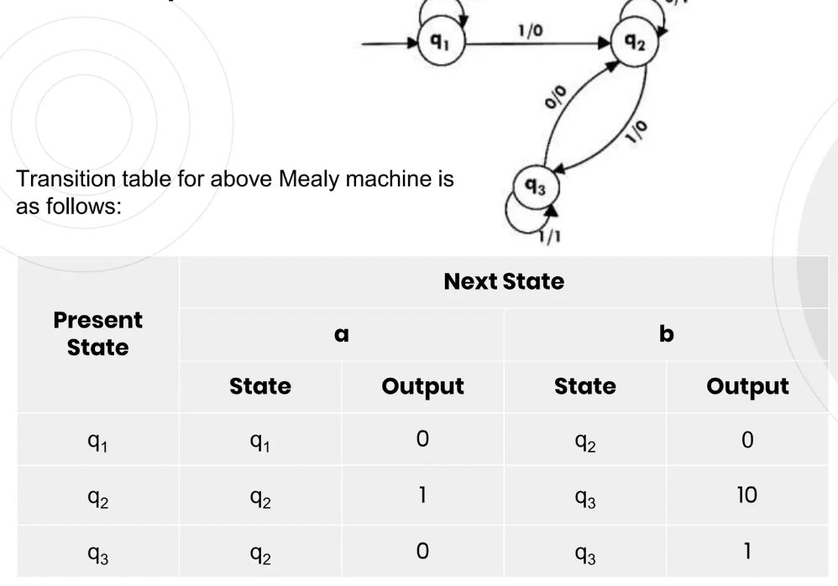
Example

Slide 24
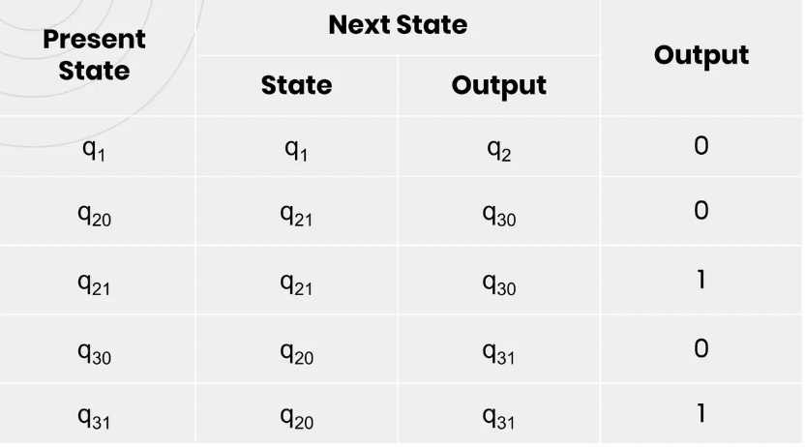
Transition table for Moore machine:

Slide 25
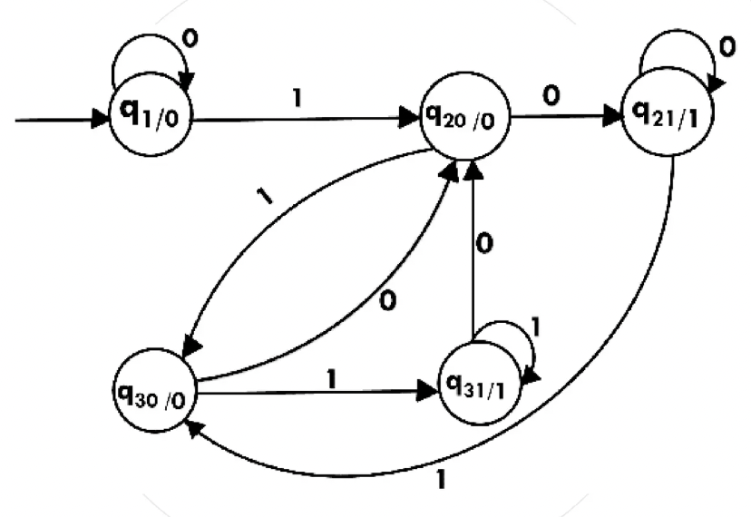
Transition diagram will be:-

Slide 26
Thank you!
In this video what we learned in brief was all the basic and necessary terms used in automata like – regular expressions, Finite Automata, Deterministic Finite Automata(DFA) & Non-Deterministic Finite Automata(NFA).
We also learned how to convert a NFA to DFA as well as how to convert a eplsion NFA to DFA.
To clear the concepts, we also did some examples used in previous year question paper for better understanding of the topics.
Stay tuned for the next video we will cover conversion of Moore to Mealy and vice-versa as well as Arden’s Theorem.

